Slide 1
Term-document incidence matrices

Slide 2
Unstructured data in 1620
Sec. 1.1
Which plays of Shakespeare contain the words Brutus AND Caesar but NOT Calpurnia?
One could grep all of Shakespeare’s plays for Brutus and Caesar, then strip out lines containing Calpurnia?
Why is that not the answer?
Slow (for large corpora)
NOT Calpurnia is non-trivial
Other operations (e.g., find the word Romans near countrymen) not feasible
Ranked retrieval (best documents to return)
Later lectures
Notes:
Grep is line-oriented; IR is document oriented.

Slide 3
Term-document incidence matrices
Sec. 1.1
1 if play contains word, 0 otherwise
Brutus AND Caesar BUT NOT Calpurnia

Slide 4
Incidence vectors
Sec. 1.1
So we have a 0/1 vector for each term.
To answer query: take the vectors for Brutus, Caesar and Calpurnia (complemented) ➔ bitwise AND.
110100 AND
110111 AND
101111 =
100100

Slide 5
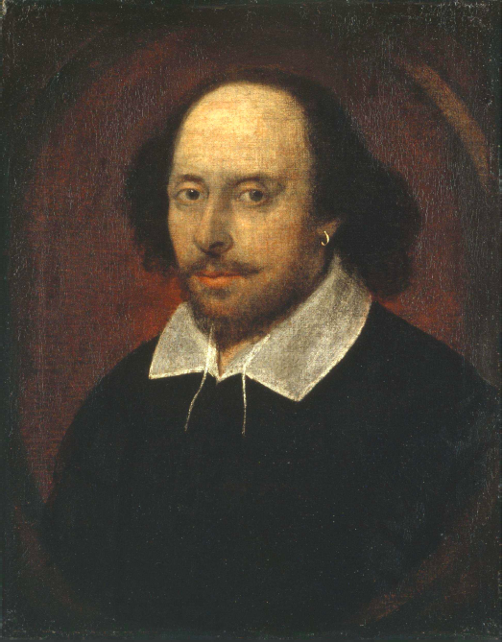
Answers to query
Sec. 1.1
Antony and Cleopatra, Act III, Scene ii
Agrippa [Aside to DOMITIUS ENOBARBUS]: Why, Enobarbus,
When Antony found Julius Caesar dead,
He cried almost to roaring; and he wept
When at Philippi he found Brutus slain.
Hamlet, Act III, Scene ii
Lord Polonius: I did enact Julius Caesar I was killed i’ the
Capitol; Brutus killed me.
Notes:
Wikimedia commons picture of Shake

Slide 6
Bigger collections
Sec. 1.1
Consider N = 1 million documents, each with about 1000 words.
Avg 6 bytes/word including spaces/punctuation
6GB of data in the documents.
Say there are M = 500K distinct terms among these.

Slide 7
Can’t build the matrix
Sec. 1.1
500K x 1M matrix has half-a-trillion 0’s and 1’s.
But it has no more than one billion 1’s.
matrix is extremely sparse.
What’s a better representation?
We only record the 1 positions.
Why?

Slide 8
Term-document incidence matrices

